Slide 1
Distributed ChatSDK for iOS
Benedikt Kaiser 4. März 2024
Mobile Computing Master

Slide 2
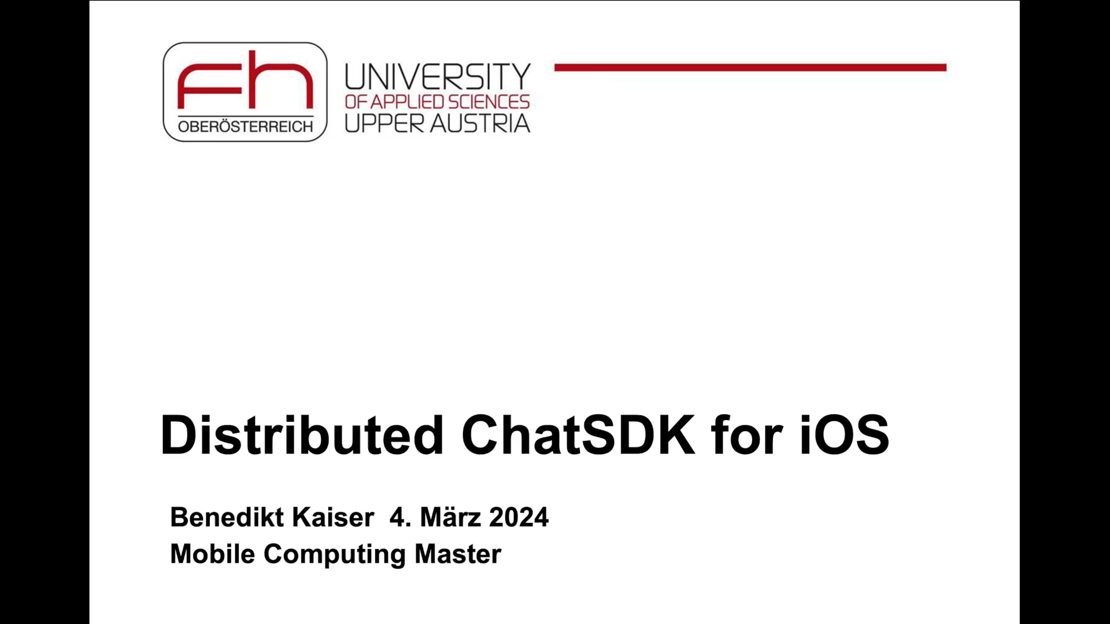
Introduction
Video

Slide 3
Introduction
Goals
Is it possible to create a ChatSDK that is completly serverless?
How well does it work and can it be scaled?
What are the limitations?

Slide 4
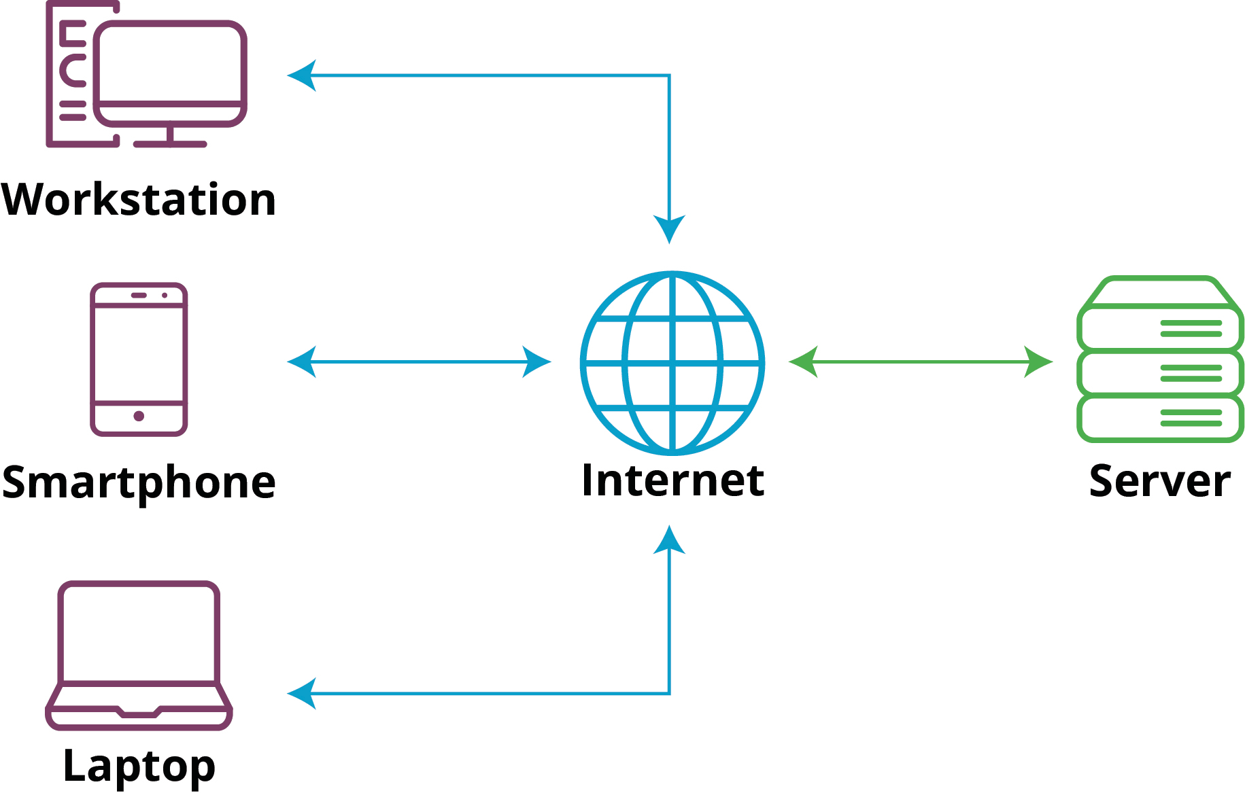
Introduction
Conventional Chat architecture
Advantages:
Easy to govern
Creating Backups is easy
Easy to scale
Easy to share resources
Simplified Updates
Disadvantages:
Single Point of Failure
Cost
Privacy
Maintenance Complexity

Slide 5
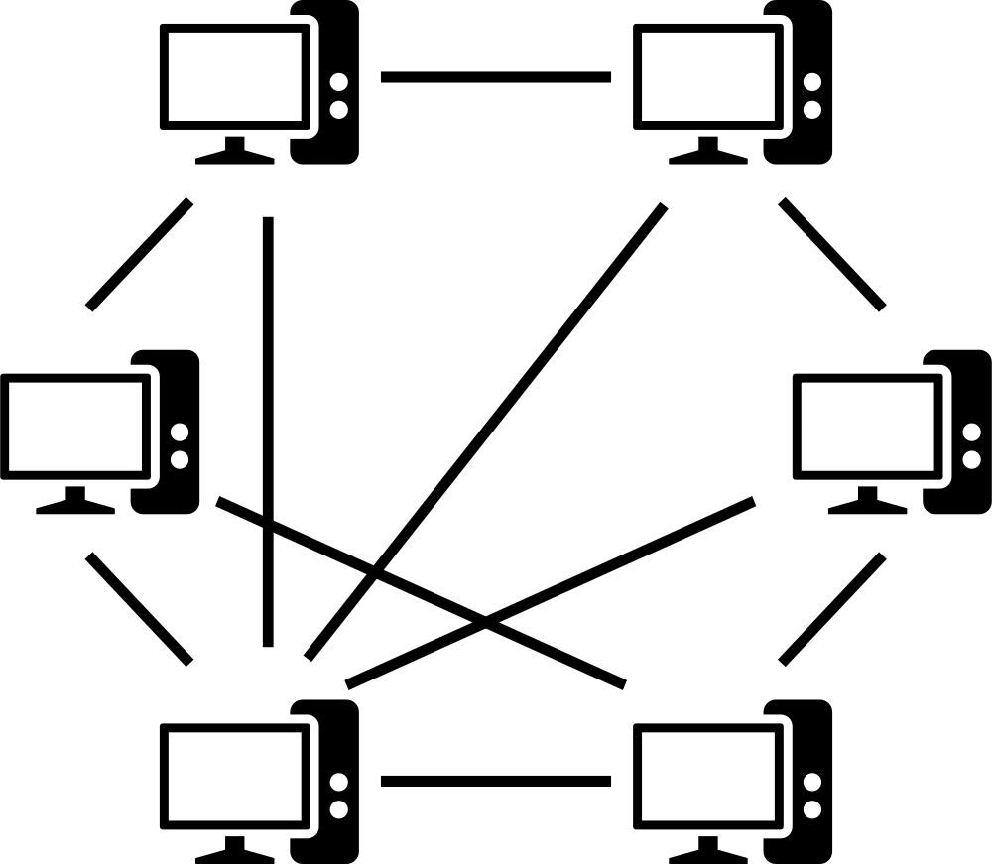
Introduction
Serverless Chat architecture
Advantages:
No single Point of failure
If done right, good scalability
Good Privacy
Offline Functionality
Resource Efficiency
Disadvantages:
Initial Connection Challenges
Consistency issues
Limited Control
Maintenance Complexity
Notes:
Decentralization: Peer-to-peer (P2P) serverless architecture eliminates the need for a central server, distributing the communication load across all participating clients. This decentralization can lead to increased robustness and resilience.
Reduced Latency: P2P architecture can potentially reduce latency since communication happens directly between peers without intermediaries. This is especially beneficial for real-time applications like chat where low latency is crucial.
Scalability: P2P systems can be inherently scalable as each participant contributes to the network. The network can grow without the need for a centralized entity to manage the increasing load.
Improved Privacy: Since there is no central server storing user data, privacy concerns related to a central repository are minimized. Users have more control over their data, and there is no single point of vulnerability for a potential data breach.
Offline Functionality: P2P systems can often support offline functionality, allowing peers to communicate directly when the network connection is available, even if there's no internet access.
Resource Efficiency: Without the need for a central server managing communication, resource consumption and operational costs can be reduced, making P2P architecture potentially more efficient in terms of resource utilization.
Complex Network Management: Managing a decentralized network can be complex. Issues such as peer discovery, NAT traversal, and maintaining network stability can pose challenges.
Security Concerns: P2P architectures may face security challenges, as communication is direct between peers. Ensuring secure communication, authentication, and data integrity become more critical in such scenarios.
Limited Control: With a serverless architecture, there might be limited control over the communication flow compared to a server-client model. This lack of centralized control can make it challenging to enforce certain policies or moderation.
Reliability: Peer connections are dependent on the availability of other peers. If a critical peer goes offline or experiences issues, it may impact the overall reliability of the system.
Initial Connection Challenges: Establishing direct connections between peers can be challenging, especially in network environments with firewalls or NAT devices. Techniques like hole punching and traversal protocols are often needed.
Consistency Issues: Ensuring consistency in a decentralized system can be more challenging than in a server-client model. Synchronization of data, such as chat history, may require additional measures.
Difficulties in Large-Scale Deployments: While P2P systems can be scalable, managing very large networks with a significant number of peers may become complex and require sophisticated algorithms for efficient operation.

Slide 6

Introduction
Problems with Peer to Peer (P2P)
Retrieve an initial non static IP address to join the network
Retrieve the current IP address
Network address translation (NAT) and Firewall traversal

Slide 7
Methodology
Joining the Network
Central Server
Bootstrap Nodes
Local Network Discovery (like mDNS)
Internet Protocol over Avian Carriers
Interface (Procotol)
Notes:
One Central server that with a fixed IP Address that sends you the ip address of one node if requested
Bootstap nodes, similair to central server but the bootstrap node but is not a central server but just a well known node
Multicast DNS finds other nodes but only in the same network. Really useful for the same/small network but not usefull for larger networks
IPoAC, if you know somebody that is already in the network, they can send you a invitation or you can just type in the IP address if you are standing next to each othet

Slide 8
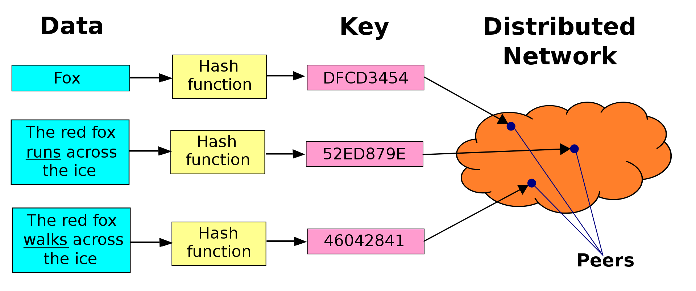
Methodology
Retrieving the current IP address
Distributed Hash Tables (DHT) with Kademlia: A Peer-to-Peer Information System Based on the XOR Metric
Notes:
Daten werden gehasht und dieser Key wird gespeichert, die liste der gespeicherten keys wird aufgesplittet dass jedes gerät zB nur 10 einträge hat. Wenn man nun einen Eintrag finden will, sucht man nach dem hashwert in dieser liste

Slide 9

Methodology
Retrieving the current IP address
Kademlia: A Peer-to-Peer Information System Based on the XOR Metric
000
001
010
011
100
101
110
111
V1
n2
001
010
011
XOR
Distance: 3
Notes:
Global Keyspace

Slide 10
Methodology
Retrieving the current IP address
Kademlia: A Peer-to-Peer Information System Based on the XOR Metric
000
001
010
011
100
101
110
111
V1
n2
100
101
001
XOR
Distance: 1
Notes:
Global Keyspace

Slide 11
Methodology
Retrieving the current IP address
Kademlia: A Peer-to-Peer Information System Based on the XOR Metric
000
001
010
011
100
101
110
111
V1
n2
001
101
100
XOR
Distance: 4
Notes:
Global Keyspace

Slide 12
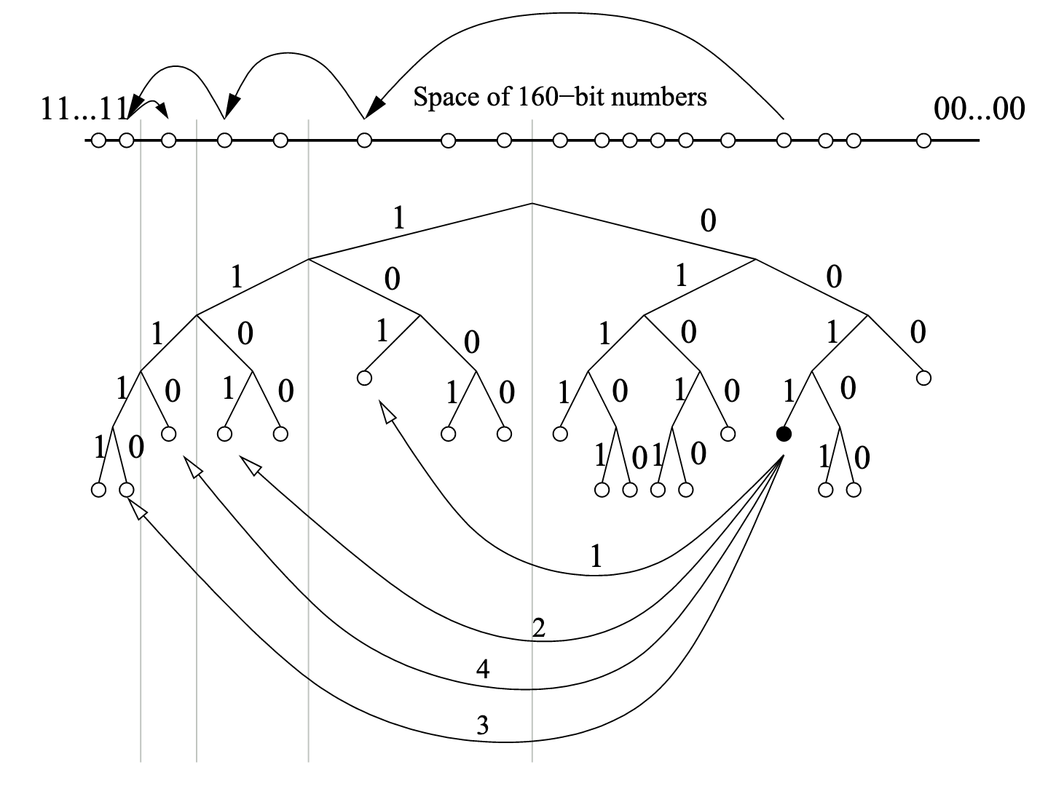
Methodology
Retrieving the current IP address
Kademlia: A Peer-to-Peer Information System Based on the XOR Metric
Notes:
libp2p is a modular system of protocols, specifications and libraries that enable the development of peer-to-peer network applications. There are many distributed peer-to-peer network models with different challenges and tradeoffs that try to improve on the way we network. Libp2p aims to be a modular, general-purpose toolkit for any peer-to-peer application.

Slide 13
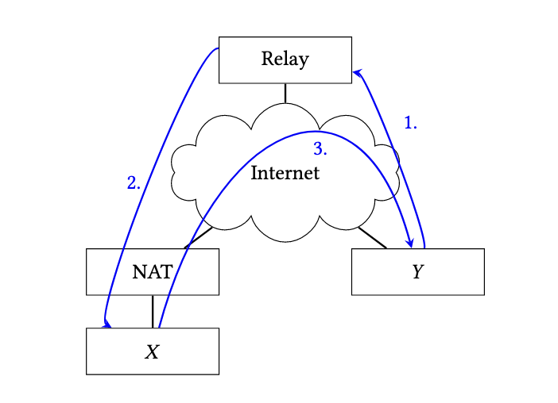
Methodology
NAT traversal
Holepunching/DCUtR
Notes:
Direct Connection Upgrade through Relay

Slide 14

LibP2P
A modular network stack
“
Discovering and connecting with other peers is a key challenge in P2P networking. In the past, each P2P application had to develop its own solution for this problem, leading to a lack of reusable, well-documented P2P protocols.
”
- LibP2P
Notes:
libp2p was initially developed as part of the InterPlanetary File System (IPFS) project as its wire protocol but has since phased out into a networking stack that has been adopted by a wide range of other projects as a networking layer.
libp2p is a modular system of protocols, specifications and libraries that enable the development of peer-to-peer network applications. There are many distributed peer-to-peer network models with different challenges and tradeoffs that try to improve on the way we network. Libp2p aims to be a modular, general-purpose toolkit for any peer-to-peer application.

Slide 15
Scalability
Max Hops: O(log(n))
Network with 10³ Users = max 3 Hops
Network with 10⁶ Users = max 6 Hops
Notes:
After 3 Hops it is possible to reach every single Node in the Network

Slide 16
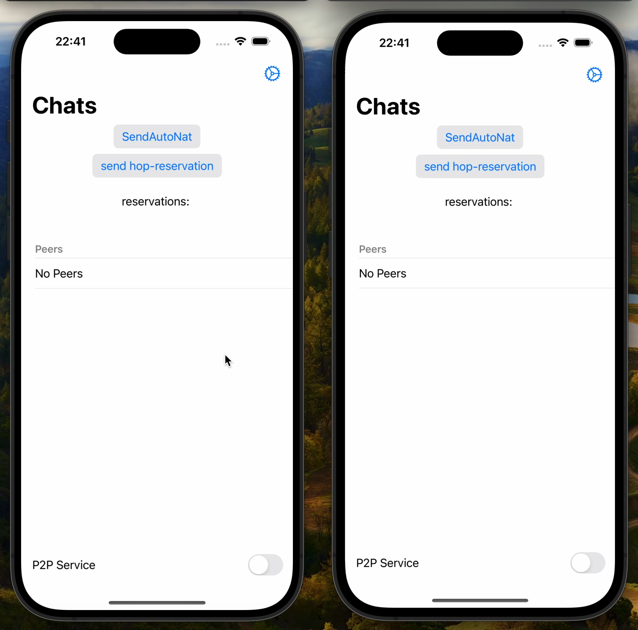
Demo
Notes:
After 3 Hops it is possible to reach every single Node in the Network

Slide 17
Conclusion
Using Distributed Hash Tables to retrieve the IP address works
NAT & Firewall Traversal are big challenges
Entering a Network depends on the Application
DHTs scale well even in a large Network

Slide 18
Distributed ChatSDK for iOS
Benedikt Kaiser 4. März 2024
Mobile Computing Master

